Slide 1
Transition Process of the Policies Regarding Korean Nuclear Fuel Cycle and Activities of Civil Society
HyeJeong Kim
Chairperson of Nuclear Free Committee
Korea Federation for Environment Movement

Slide 2
History of Nuclear fuel cycle development

Slide 3
Rhee Syngman Govt,1948~1960 :Introducing and researching nuclear energy
1956, announced the Korea-U.S. Atomic Energy Agreement
1958, introduced a research reactor, TRIGA MARK II from the US for the first time of the governments
1959, opened the Atomic Energy Board as one of the gov’t departments & founded Korea Atomic Energy Research Institute (KAERI)
The gov’t introduced nuclear energy to develop nuclear weapon rather than utilizing nuclear power.

Slide 4
Park Chung-hee Govt , 1963~1979 : Development regarding nuclear fuel cycle & policy ①
Gov’t was more closely connected to developing the nuclear weapon in 1970s.
KAERI had prioritised establishment of nuclear fuel cycle technology, concentrated on research & develop the technologies of processing & reprocessing.
Started introducing a nuclear fuel reprocessing facility& MOX from the UK and France.
Park pushed forward introducing Canadian CANDU heavy-water reactor. KAERI suggested building NRX & a nuclear fuel fabrication plant in parallel with introducing the heavy-water reactor.

Slide 5
Park Chung-hee Govt, 1963~1979 : Development regarding nuclear fuel cycle & policy②
In 1971~1972, KAERI & Young Nam Hwahak tried to build reprocessing plant
The US opposed Korea introducing the nuclear fuel cycle technology & required France & Canada to discontinue exporting the reprocessing plant, the heavy-water reactor.
The export & import bank of the USA determined not to permit the loan for second reactor(Gori NPP 2) & the guarantee for the loan until Korea would join NPT

Slide 6
Park Chung-hee Govt, 1963~1979 : Development regarding nuclear fuel cycle & policy③
Finally, the gov’t withdrew the introduction of the reprocessing facility and NRX and discontinued the secret project 890.
As a result, the loan agreement with Canada resumed, the export and import bank of the US approved the loan, and the US granted official permission to export the nuclear reactor for Gori NPP 2.
However, Park gov’t & the nuclear groups didn't completely give up on the development of nuclear technology. Later, they indirectly kept pushing forward in far stricter secrecy.

Slide 7
Park Chung-hee Gov’t, 1963~1979 :Development regarding nuclear fuel cycle & policy④
To escape the eyes of the US, Park disguised underlying military purpose as the peaceful use in a thorough way. Gov’t founded the solution at localisation of the nuclear industry.
President Park set his sights on the localisation of the nuclear industry and securement of independent nuclear fuel technology.
At the same time, undertakings that could convert to reprocessing technology were carried forward, such as mixed nuclear fuel fabrication plant, the spent nuclear fuel test facility.

Slide 8
Chun Doo-hwan Govt, 1980~1988 : Indirect Development of Nuclear Fuel Cycle
After Park Chung-hee died in 1979, the new military authority took power, the absence of the strong supporter of the development of nuclear technology put the secret project's future in jeopardy.
The new military authority took over the gov’t in a military coup and suspended the development of a nuclear weapon to obtain the support of the USA, even instructing on disorganisation of KAERI.
KAERI persuaded the new gov’t of the localisation of heavy-water nuclear fuel & others & made them national projects, which gave way out to the organisation.

Slide 9
Roh Tae-woo Govt, 1988~199 : Announcing the inter-Korean denuclearization pact
In1991, made a declaration for the denuclearization of the Korean Peninsula & establishment of peace;
① South and North Korea do not test, manufacture, produce, receive, possess, store, deploy or use a nuclear weapon;
② The two sides use the nuclear energy for peaceful purpose only;
③ The two sides do not possess a nuclear reprocessing, or a uranium enrichment facility.
Nevertheless, KAERI didn't stop researching or developing the nuclear fuel cycle technology & even carried out a uranium enrichment experiment.

Slide 10
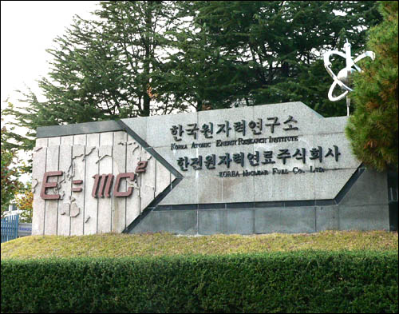
Kim Dae-jung Govt,1998~2003 : KAERI’s secret uranium enrichment
Between January and March in 2000, KAERI secretly carried away the laser enrichment experiment three times and produced 0.2g of enriched uranium.

Slide 11
Roh Moo-hyun Govt, 2003~2008 :Announced 4 Principles of Peaceful Nuclear Usage
In 2004, the investigation for secret uranium enrichment facility of IAEA revealed. The enriched uranium KAERI produced contained 77% of uranium 235
KAERI was hiding it & found out by IAEA. The case was about to be relegated to the U.N. Security Council, but the Gov’t convinced them that it had been out of 'the scientists' curiosity & mistake' so they could avert punishment.
Finally, Roh gov’t officially announced 'Four Principles of Peaceful Nuclear Usage' which confirmed we had no intention to develop a nuclear weapon.

Slide 12
Lee Myung-bak Gov’t, 2008~2013 : Determined reprocessing & fast breeder development
In 2008, determined to reprocess the spent nuclear fuel and commercialise & develop the fast – breeder reactor
In 2011, Lee confirmed the plan for the development of sodium-cooled fast breeder reactor and prototype reactor by 2028, with the plan for the development of the pyro-processing & the fast reactor nuclear fuel cycle system
The biggest obstacle to the reprocessing business, pyro-processing, was the Korea-U.S. Nuclear Energy Agreement where the US prevented Korea from running a reprocessing business without the approval of the US.
The Lee set a governmental policy to commercialise and develop the pyro and actively lobbied the US government to revise the Korea-U.S. NEA.

Slide 13
Park Geun-hye Govt, 2013~Present : Revising the Korea-U.S. Nuclear Energy Agreement
Park Keun-hye gov’t took power in 2013. She met representatives of the USA & required the revision of the Korea-U.S. NEA even before the authority officially started.
USA revised the agreement that they allow Korea to enrich U.S. uranium less than 20% and research the pyro-processing on phase 1.
KAERI is planning to carry out the phase 1 experiment of the pyro-processing with the spent nuclear fuel from in July this year.

Slide 14
Activities of Civil society

Slide 15
Activities of Civil Society
After Fukushima disaster, people actively staged a protest against construction and extension of a nuclear power plant, which was led to the closure of Gori NPP 1 in June 2015.
In 2015, civil group took a legal action against operating license of Wolsung NPP 1 life extension by NSSC. Recently, the Court ruled that NSSC cancels the permission.
Reprocessing spent nuclear fuel and constructing a fast-reactor haven't yet been able to be a core agenda of the anti-nuclear movement.

Slide 16
Activities of Civil Society
Some hopeful perspectives; the pyro business is still in the research stage, and the US will finally oppose the reprocessing plan of Korea.
However, facing the spent nuclear fuel experiment of KAERI, an anti-reprocessing campaign has started as 'the 30km solidarity for opposition against reprocessing the spent nuclear fuel,' where the core is civic groups around.
Politics hold a debate to inform the problems of reprocessing pyro & reduce the business budget.
People can stop the pyro-reprocessing. Korean civil society has been made the impossible possible in anti nuke movement.

Slide 17
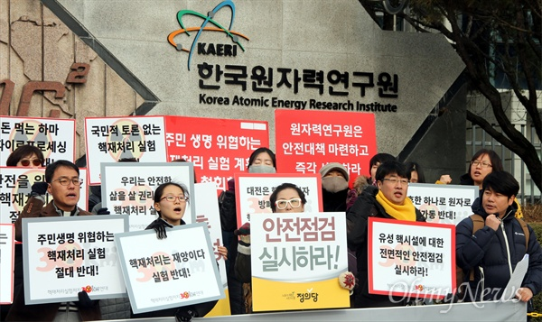
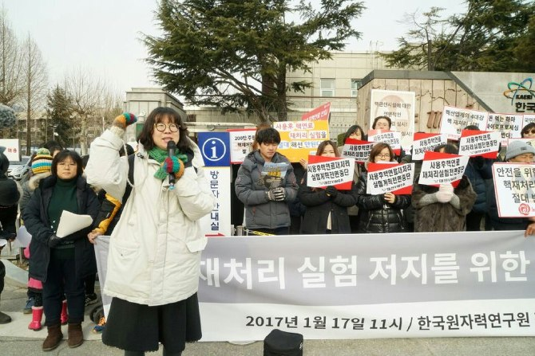
Korean civil society has been made the impossible possible in anti nuke movement!!! We can stop the reprocessing!

Slide 18
Never give up!
Hye jeong Kim
ecokim63@gmail.com

